Slide 1

USE Case
Reuter's Data

Slide 2


AGENDA
Problem overview
Data Overview
Classification
Results
Sentiment analysis
Summary

Slide 3
PROBLEM OVERVIEW
Multilabel classification to predict article topics using contextual models (LSTM/Transformers) and used zero-shot sentiment detection with keyword attribution to identify negative ICCO-related risks in cocoa news.

Slide 4
DATA OVERVIEW
Title + Text
Dataset | Sample | Features | Purpose
Train | 10744 | 2 | Model training + sentiment analysis
Validation | 1051 | 2 | Model validation
Test | 4028 | 2 | Model testing + sentiment analysis
120 unique labels

Slide 5
Classification : Multilabel Problem
Preprocessing
Seq. to seq. models
Evaluation & Output
Concatenated data from column 'title' & 'text'
Preprocessing by stopword removal, lemmatization and tokenization.
Missing topics and all training data imputed
Weighted average for class imbalance
1
Multilabel sigmoid output
Layer
[Labels] - > […prob score....]
Evaluation metric - >
F1 score, AUC score
Model prediction with
pipeline quantized for
optimized inference
LSTM with BERT Embeddings
Handles sequential text with variable context length
Transformers
Captures long term dependencies , contextual meaning
[Texts] -> [Tokens] -> ​[Embeddings]

Slide 6
ANAlysing RESULTS
LSTM MODEL | SCORE(%)
Accuracy | 62
F1 - score | 63
AUC- ROC | 64
“Transformers outperform LSTM in both accuracy and F1-score, due to better contextual understanding of multilabel semantics.”
“Model outputs reflect confident sigmoid activations, enabling threshold-tuned label selection.”
TRANSFORMERS | SCORE(%)
Accuracy | 71
F1 - score | 72
AUC- ROC | 73
The AUC score can be further improved by reducing count of labels by grouping same labels together.

Slide 7
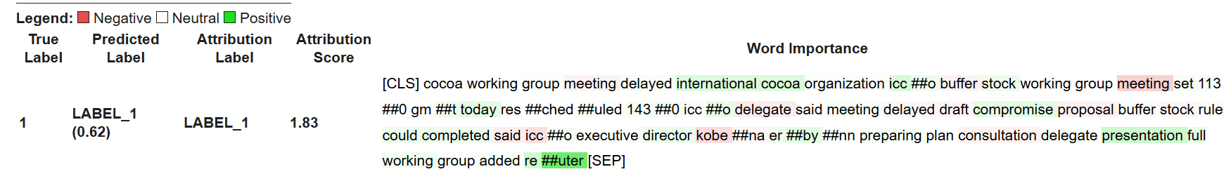

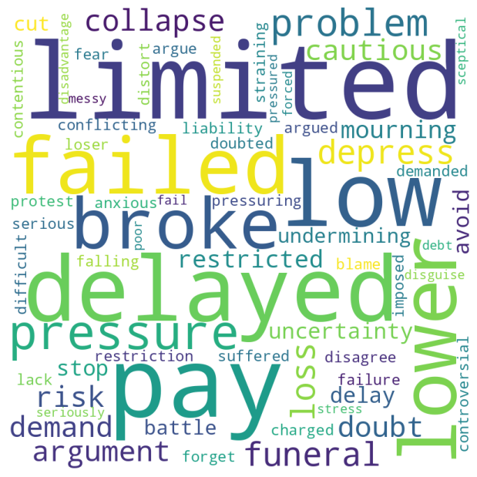
Sentiment Analysis
How to understand a sentence structure to analyze the contextual meaning? : Lexicon based summarization
Positive words and negative words
highlighted for tokens to understand
the sentence structure & classify it.
Sentiment | Score(%)
Positive | 77
Negative | 67
How do negative words look like?
BERT Zero shot classification
Bypasses the need for labeled training data, enabling rapid deployment on niche domains like ICCO risk detection
Captures nuanced sentiment beyond keyword matching, leveraging BERT's deep contextual understanding
Word cloud for extracting words / tokens which symantically adds a sentence to negative sentiments
Notes:
“We leveraged BERT-based contextual embeddings to semantically cluster articles and assess sentiment structure in the absence of labels. While the clusters aren't sentiment-pure, they reveal underlying patterns — showing how similar tones group together.”
“To complement this, we applied zero-shot sentiment classification and visualized token-level attributions, enabling us to highlight key negative signals in ICCO-related news. We further supported this with lexicon-based word clouds to make the sentiment signals interpretable and explainable.”
“Together, these techniques form a hybrid pipeline — combining unsupervised structure discovery with interpretable zero-shot sentiment detection, ideal for domain-specific monitoring like cocoa market risks.”

Slide 8
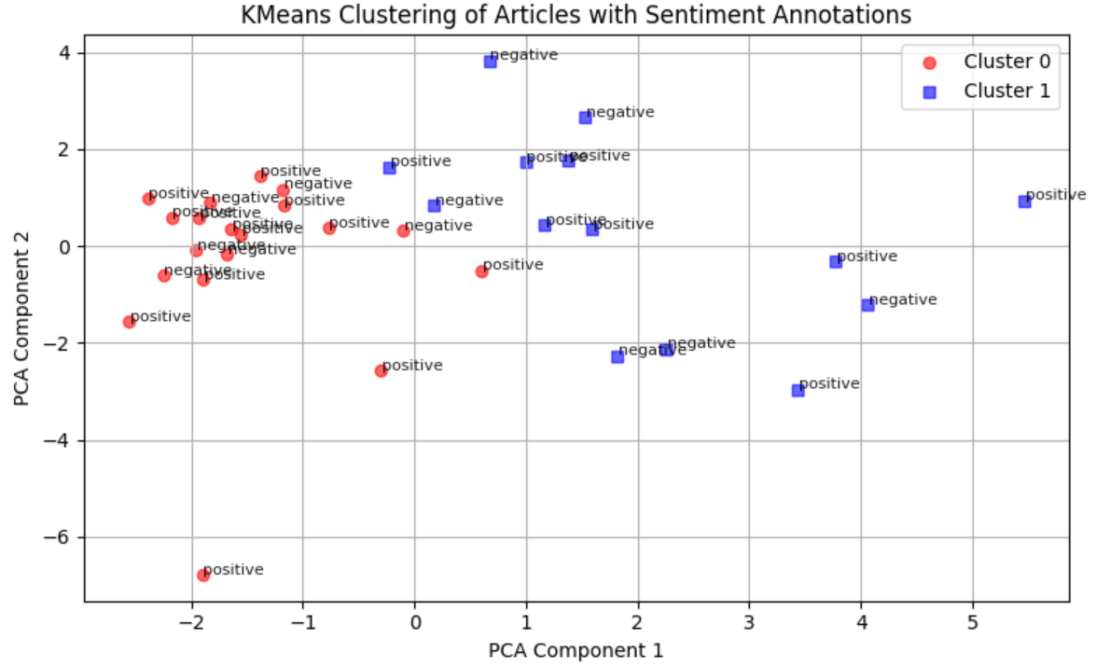
Sentiment Analysis
The key assumption here is in absence of ground truth the clusters of positive and negative examples would be distinguished after clustering
Semantic clustering of BERT
embeddings reveals partial separation between
positive and negative sentiment, indicating that
contextual tone influences grouping.
Cluster boundaries are not sentiment-pure,
showing the need for supervised refinement — but
clustering still highlights thematic grouping
Metric | Train | Test
DB Index | 2.15 | 0.62
Silhouette Score | 0.14 | 0.48
Notes:
Semantic Clustering ➤ BERT embeddings formed distinguishable clusters, showing that articles with similar narrative tone (risk vs. optimism) tend to group together — even without explicit sentiment labels.
Overlap Across Sentiments ➤ Clusters were not sentiment-pure, highlighting the nuanced, often overlapping tone of financial and commodity-related news.
Zero-Shot Classification Precision ➤ Zero-shot BERT reliably identified negative sentiment articles, especially those containing risk terms related to cocoa supply and ICCO warnings.
Lexicon Validation ➤ Word clouds of extracted negative tokens aligned well with key risk-related terms (e.g., decline, risk, uncertainty), reinforcing the model’s contextual understanding.
Explainability Through Highlighting ➤ Token-level attribution visualization helped interpret which parts of the article influenced sentiment decisions — improving trust and transparency in model outputs.

Slide 9
COnclusion
LSTM/Transformers sequence models
Label encoding/ Text cleanup
Text embedding
Model can be evaluated( AUC score) and checked continuously with concept drift and data drift. Model needs to be retrained with new data.
Deployment with containerization
Encoding of labels done and next step would be reduce labels with clustering of similar labels
BERT based embedding used. Next steps would be to use open AI embeddings & check results. Metadata like information can also be incorporated.
Incorporate the following
-Containerization
-Quantization of weights
-Finetuning with PEFT
-Monitoring with logs
Sentiment classification
Zero to one shot learning
Use a fine-tuned BERT model with rich embeddings to classify sentiment, leveraging word disambiguation for accuracy.

Slide 10
THANK YOU
Saurabh Chakravorty

Slide 11
APPENDIX

Slide 12
Growth strategy
Expand
Foster collaborative growth
Enhance
Ensure a tailored and user-focused experience
Explore
Capitalize on emerging global markets

Slide 13
summary

